Slide 1
Node-RED – WoT-Discovery Integration
Kunihiko Toumura
2021.3.5

Slide 2

Overview
In last year plugfest, we developed an Auto-population server which uses Linksmart Thing Description Directory (TDD) and DNS-SD/mDNS.
On this plugfest, we integrate query interface and node generator into Node-RED, so that the flow developer can issue a query to TDD, and install a corresponding node on-the-fly.
Node-RED
Integrated
Query interface
Things
Thing
Description
Directory
Sync script
Collects
TDs
(once an hour)
Retrieve TDs
using
JSONpath
Query
Generating
Node from TD
(Node Generator)

Slide 3
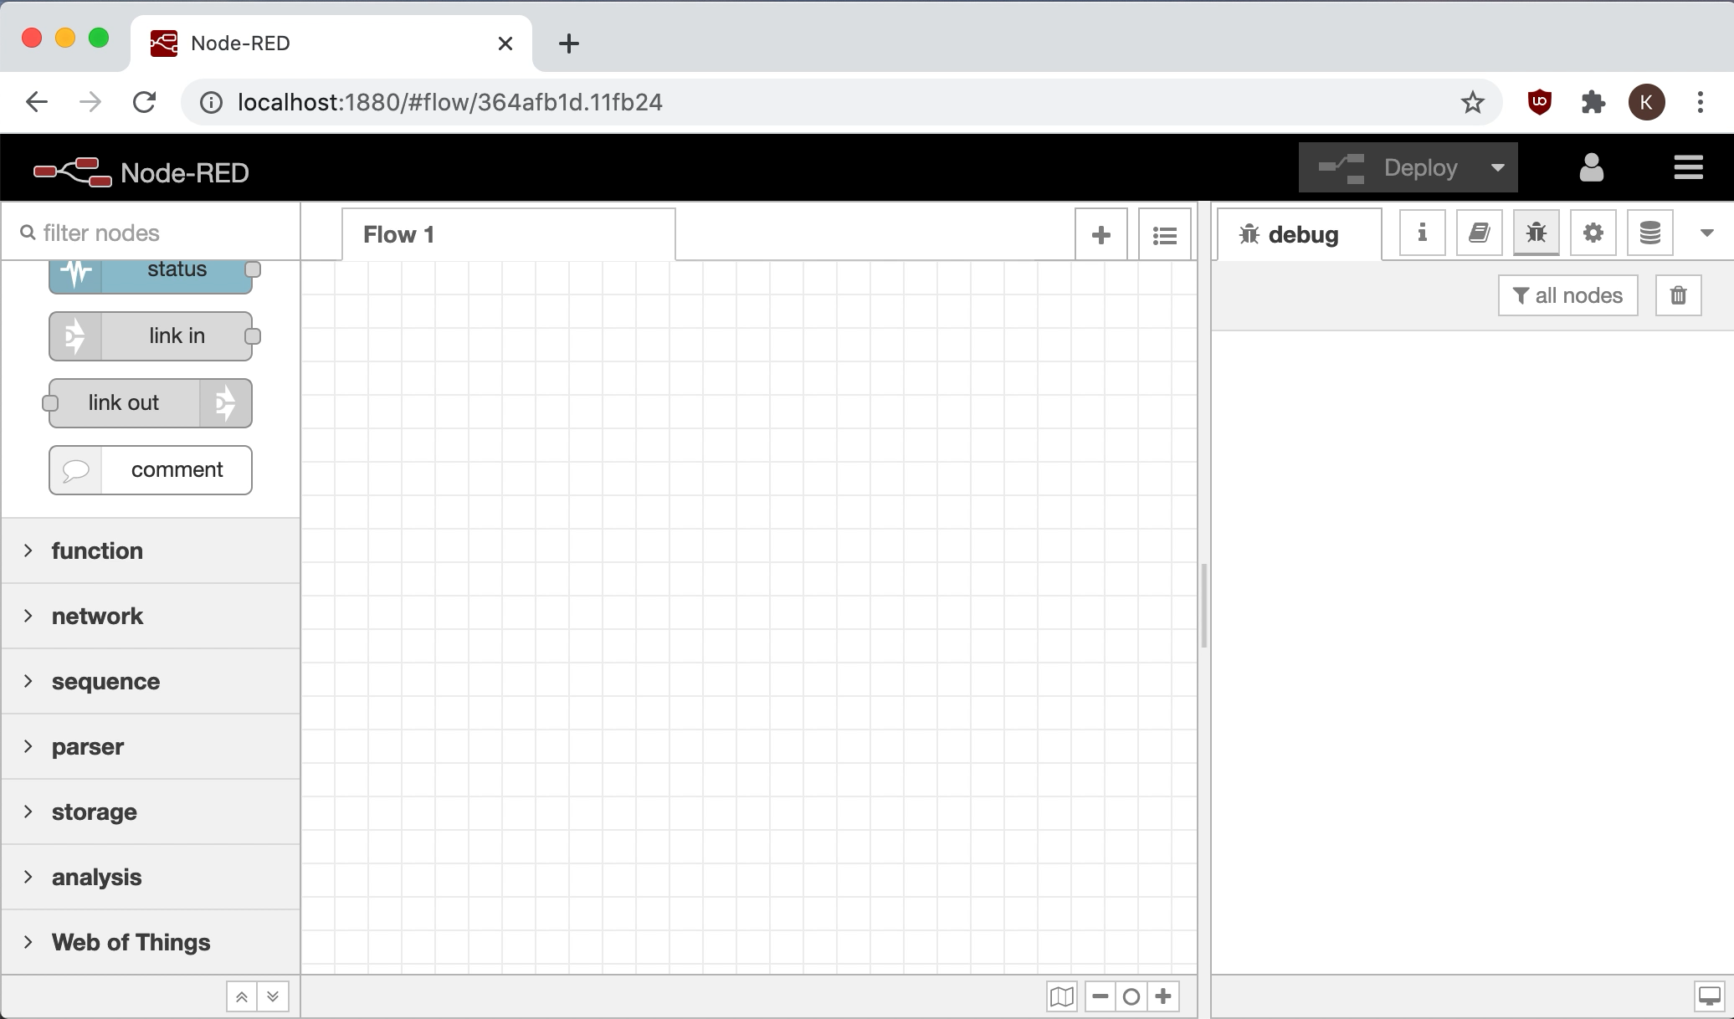

Slide 4

Appendix: Sequence diagram
GitHub
TDD
Node-RED
(server-side)
Node-RED
(browser-side)
Crawling TDs in Plugfest repository
(once a hour)
Thing Descriptions
GET /td?jsonpath=
$[?(@.title=~/coffee/ ||@.description=~/coffee/)]
Query(e.g. “coffee”)
List of Thing Descriptions
List of Things
Select a Thing
Generate a node
Confirmation
ok
install
Update palette and
display installed node

